Slide 1
CHESS SHOOTER
GAME IN UNITY
BY : MARIOS PAFITIS (xpafit00), Leonidas Achilleos (xachil00)

Slide 2
GAME DESCRIPTION
Type: 3D Top-Down Shooter
Technologies:
Unity
Blender (3D Graphics)
Photoshop CC – Procreate (2D UI Elements)
Premiere Pro (Gameplay Video Editing)

Slide 3
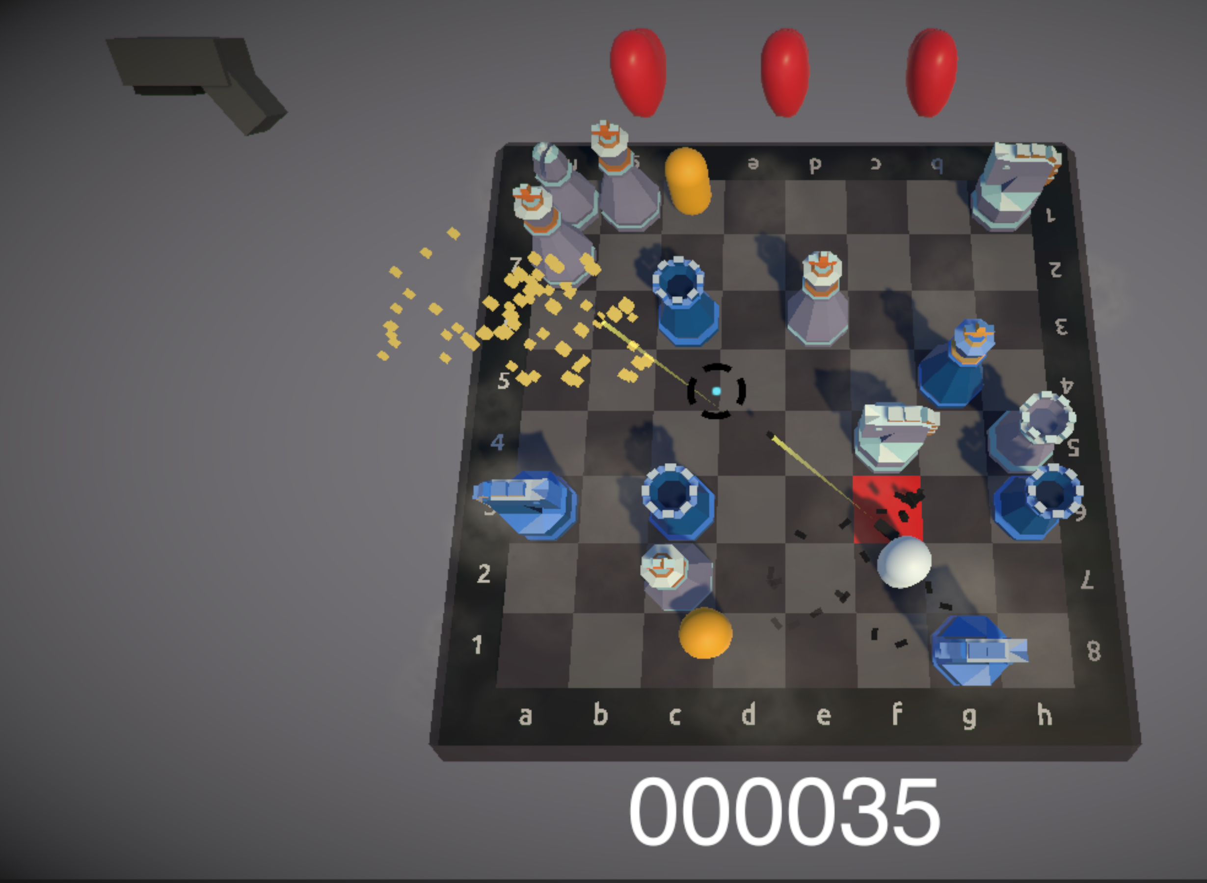
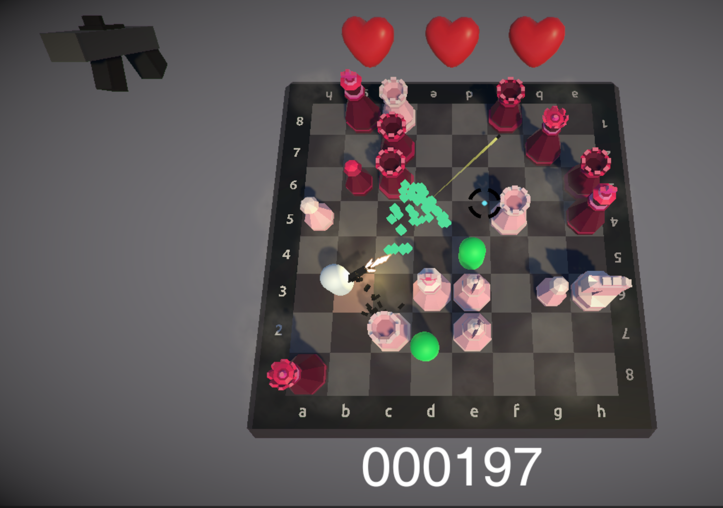
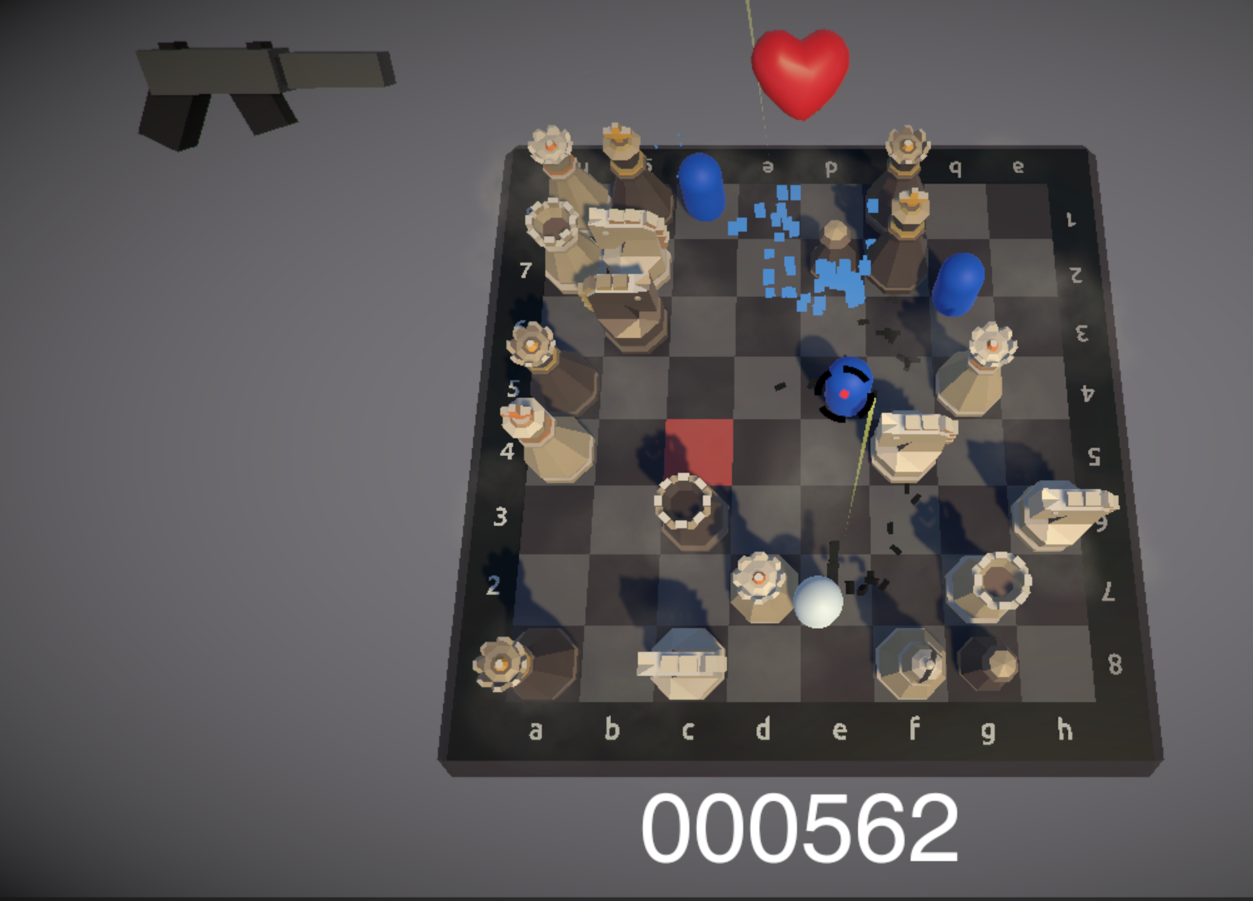
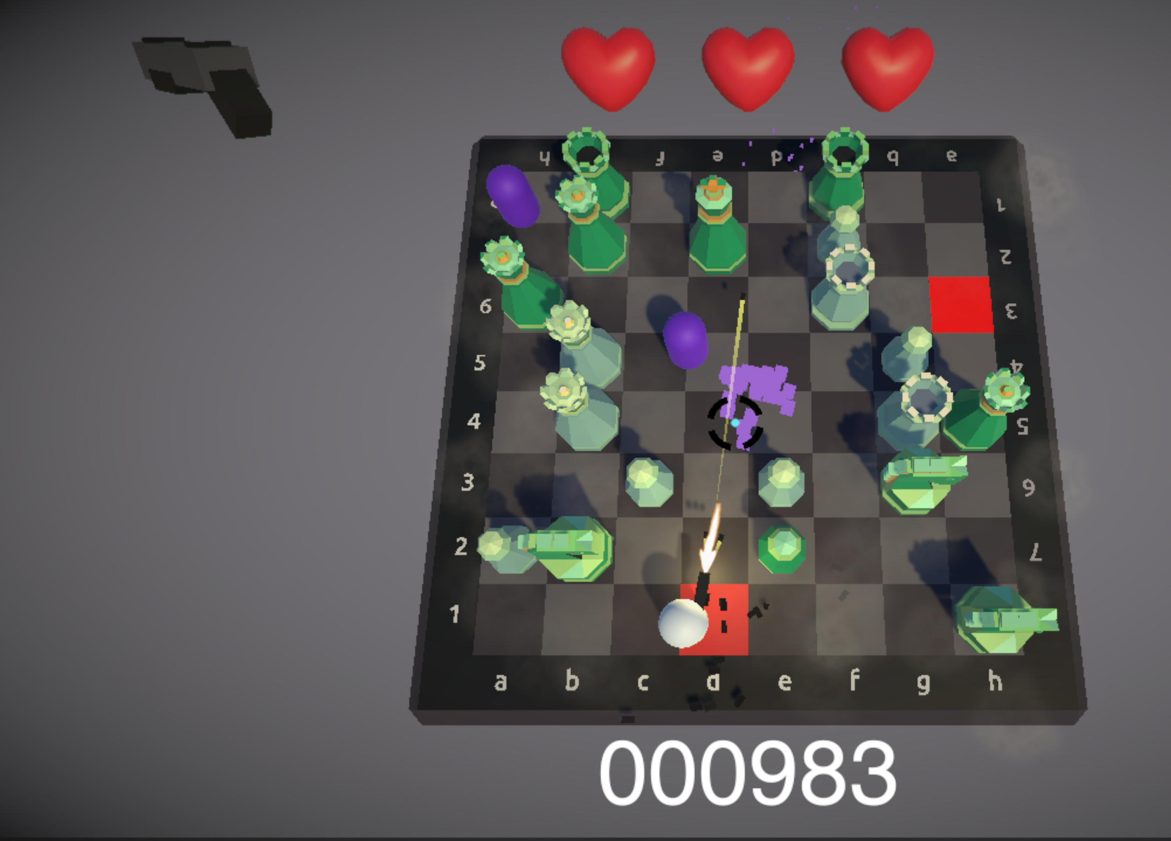
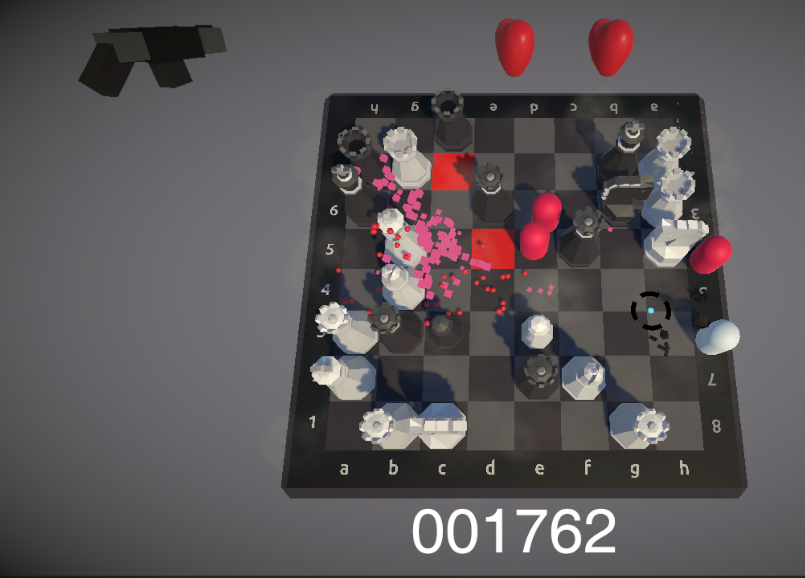
5 WAVES, Enemies & GUNS
1st
2nd
3rd
4th
5th

Slide 4
SOUND EFFECTS
Background music
Sound effects triggered by in-game events
3-2-1 Countdown
Player Death
Gun Reload (5 different tracks for each Gun)
Gun Shooting (5 different tracks for each Gun)
Enemy Attack
Enemy Death
Button Click
Level Complete

Slide 5
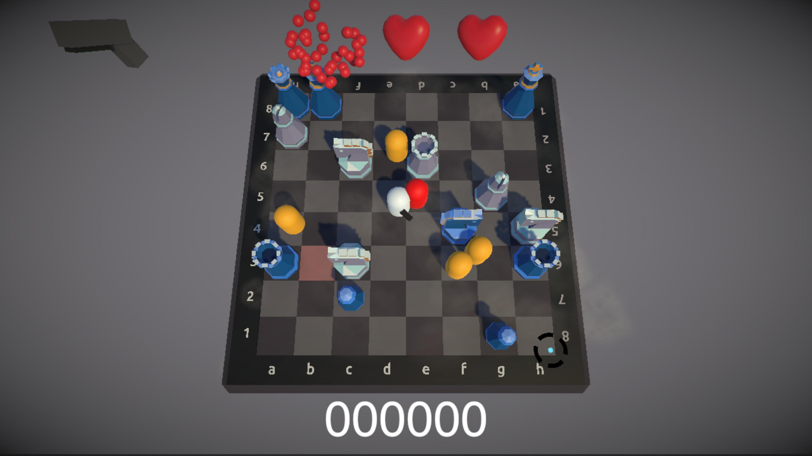
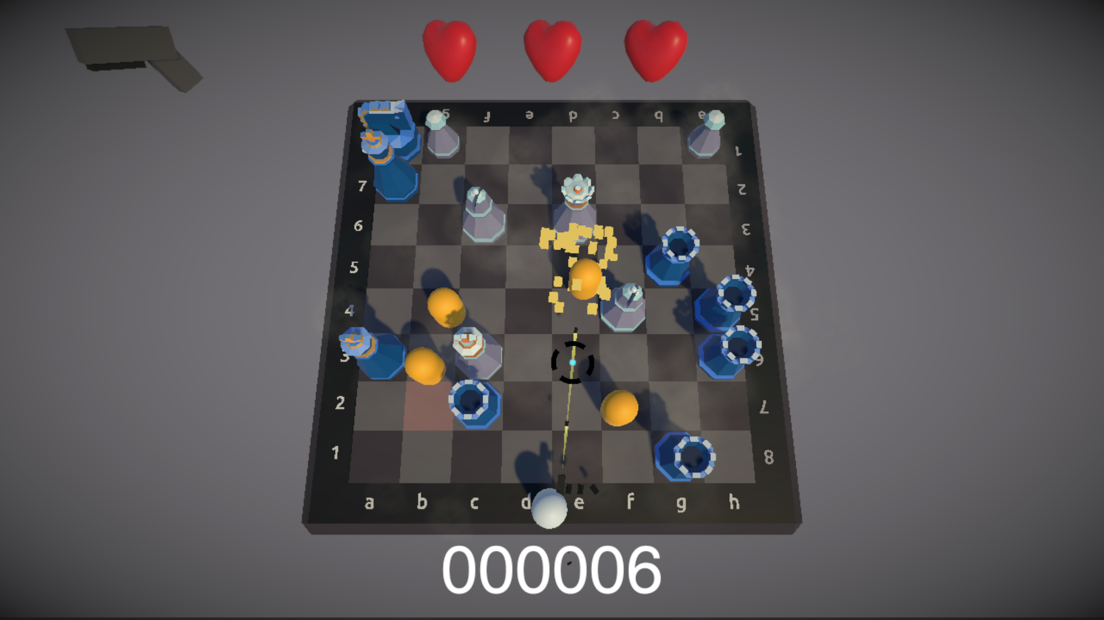
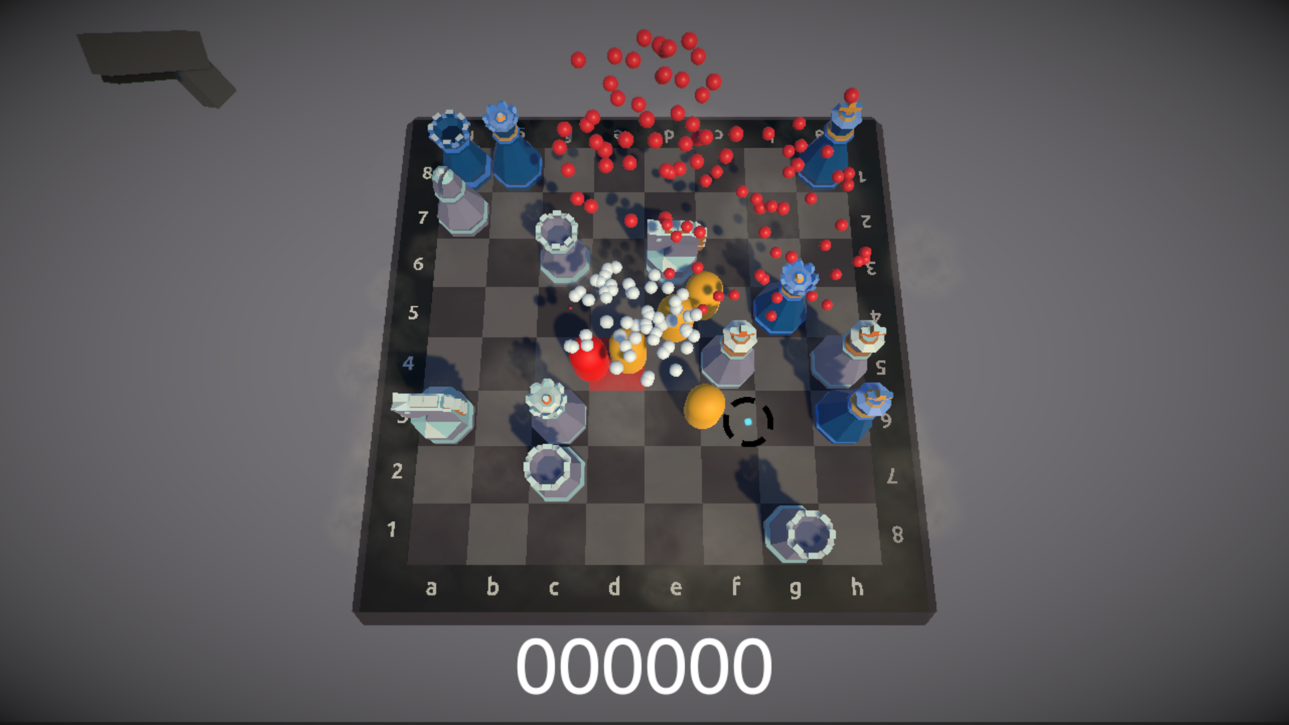
Effects 1
Heart (loose a life)
Player Death
Enemy Death

Slide 6
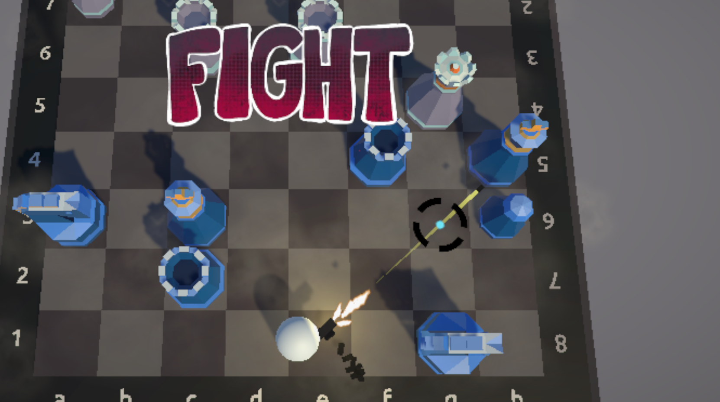
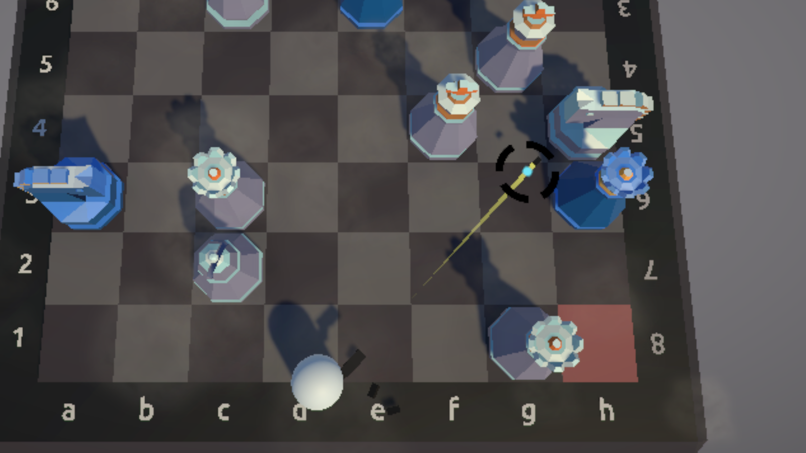
Effects 2
Player take damage
Bullet Trail
Gun Shooting Flames
Bullet Shells
Fog

Slide 7
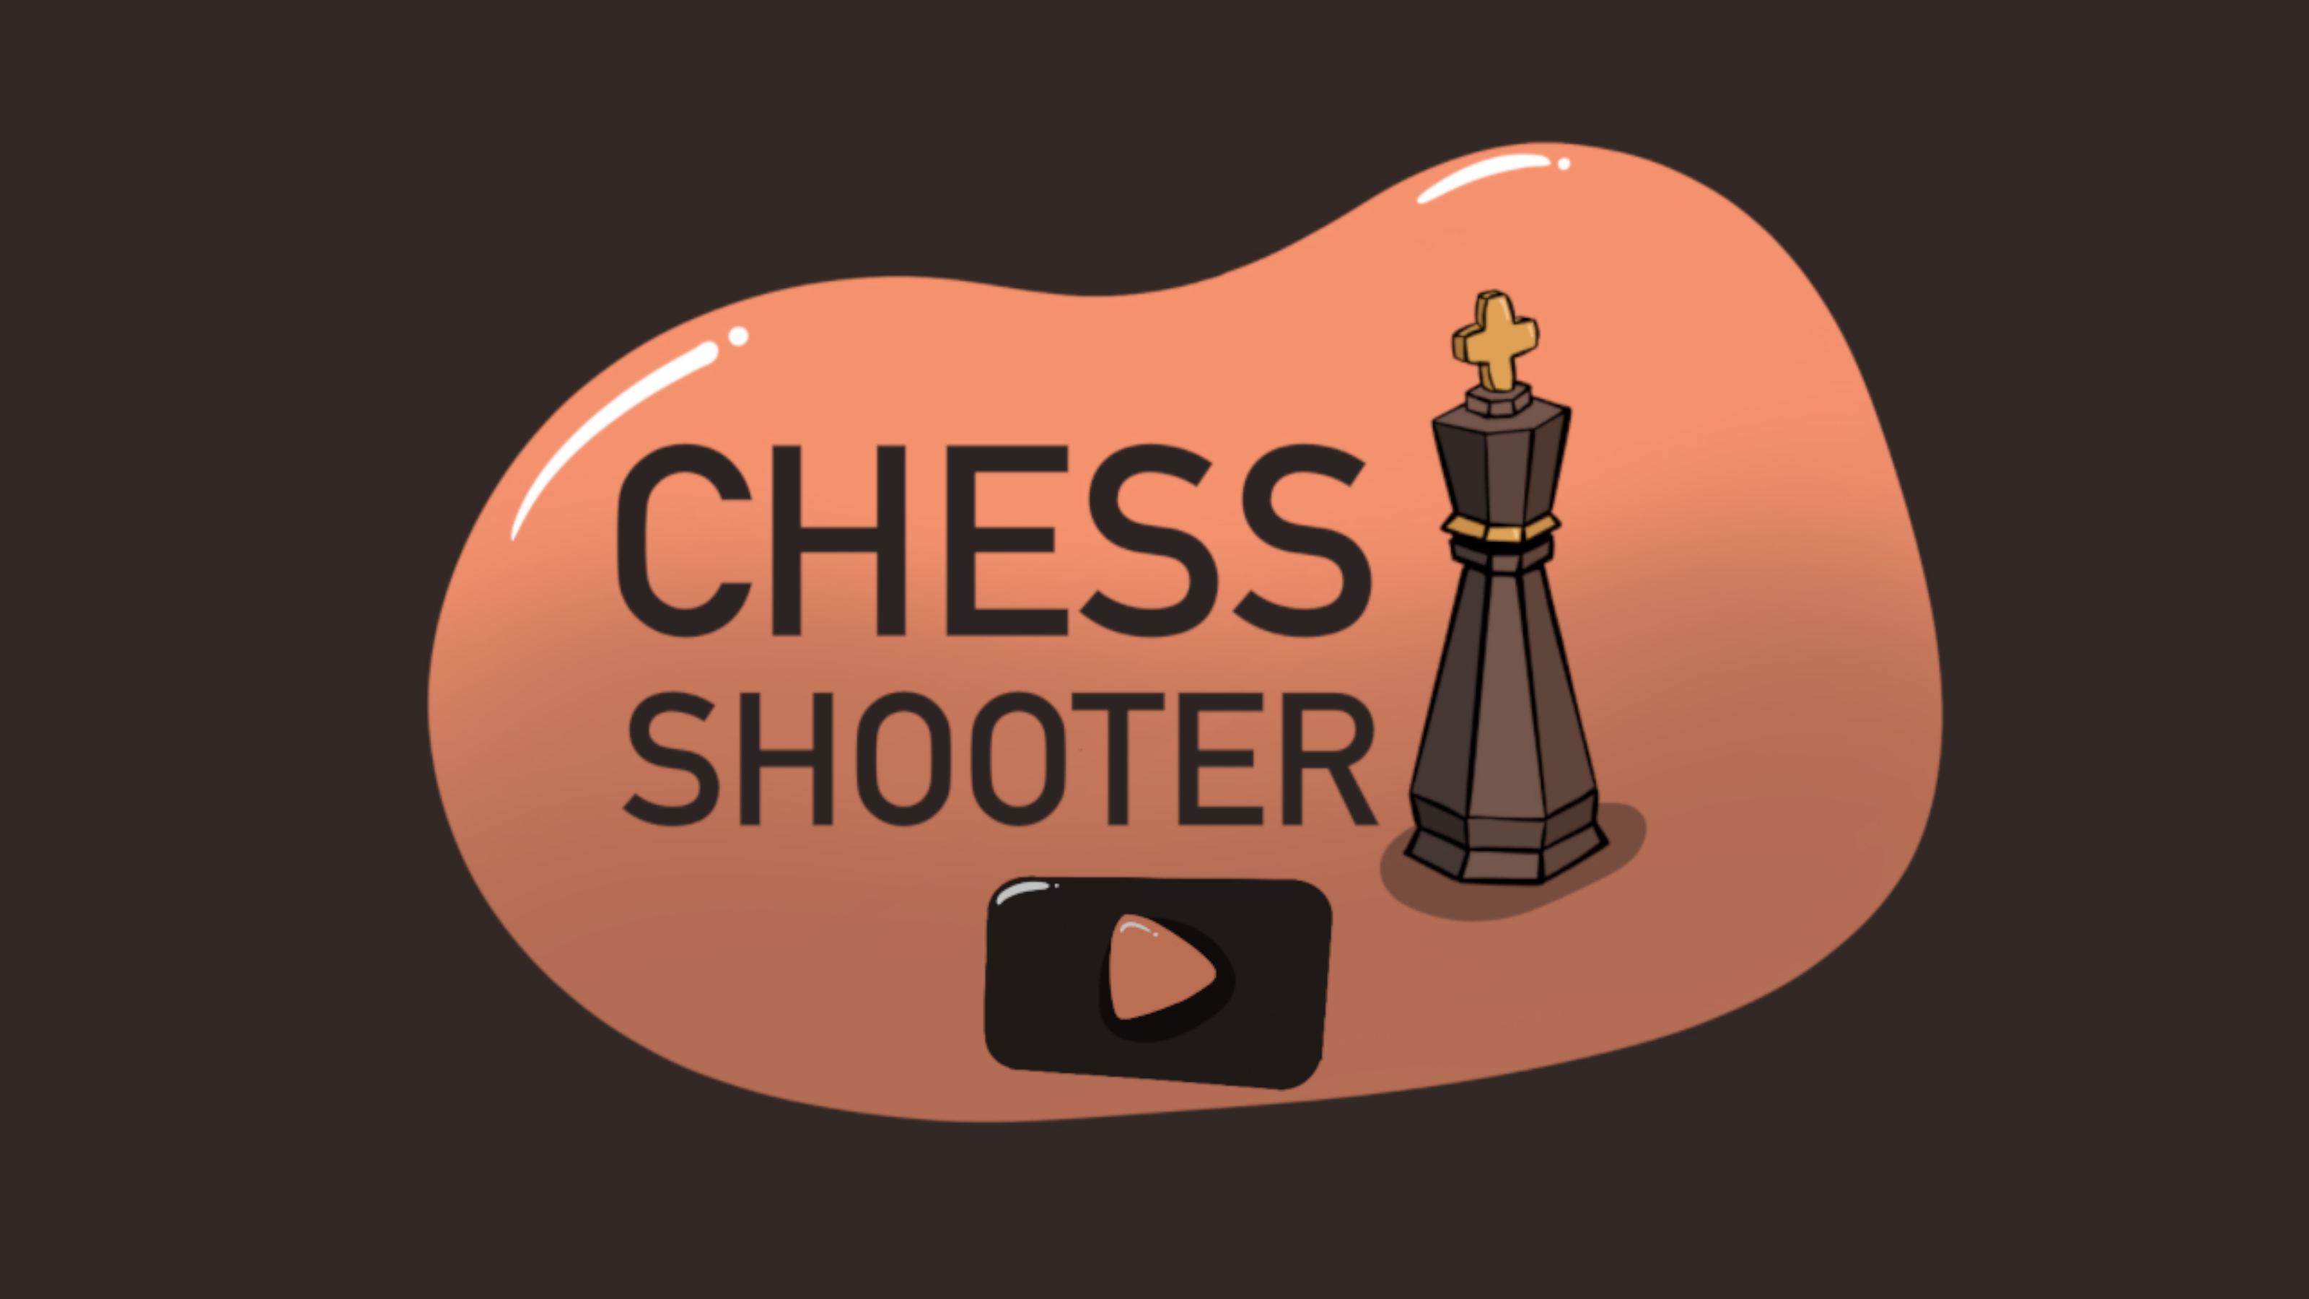
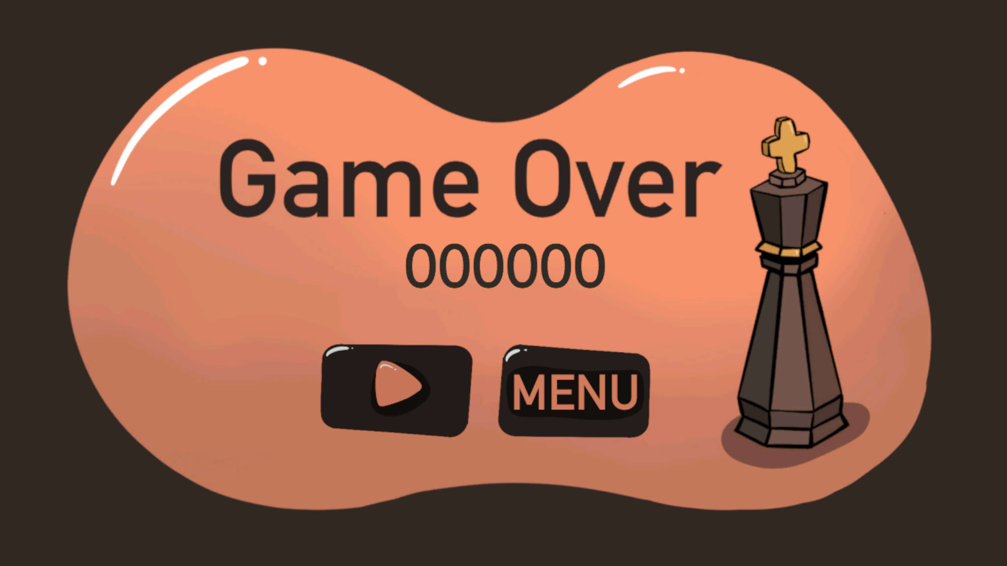
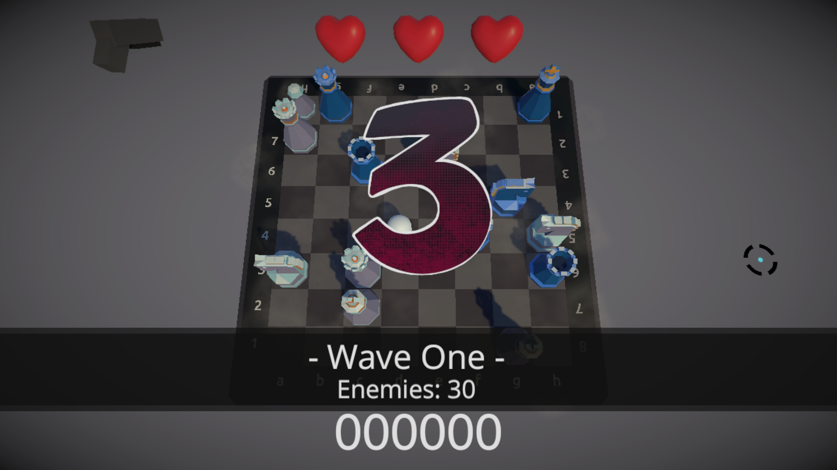
Screen transitions
Fade In – Fade Out
From Main Scene to Game Scene
From Game Scene to Game Over Menu
Moving UI Elements in each New Wave

Slide 8
Animations
Gun Reload Animation
Gun Preview Spinning Animation
Heart Preview Spinning Animation

Slide 9

Gameplay Video

Slide 10
Thank you for your attention!

